Slide 1
NoSQL (Not Only SQL)
Prof. Saed SAYAd

Slide 2
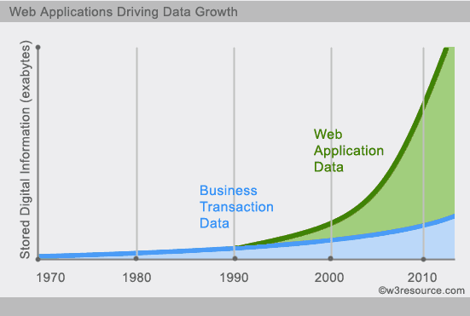
What is NoSQL?
NoSQL is a non-relational database management systems, different from traditional relational database management systems in some significant ways.
It is designed for distributed data stores where very large scale of data storing needs (for example Google or Facebook which collects terabits of data every day for their users).
These type of data storing may not require fixed schema, avoid join operations and typically scale horizontally.

Slide 3
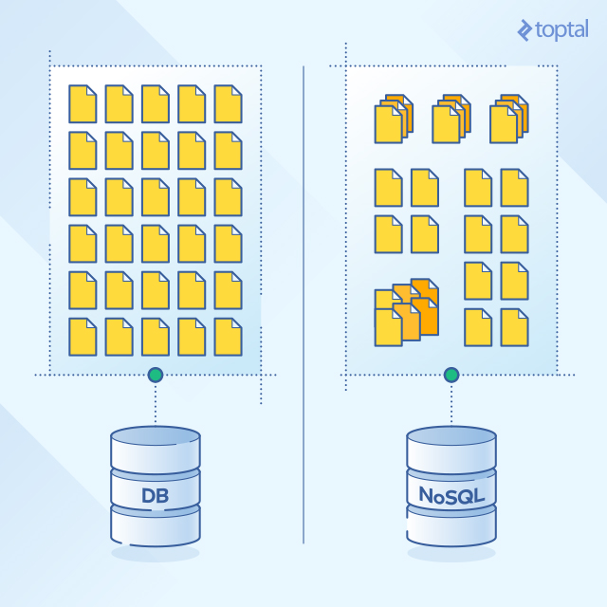
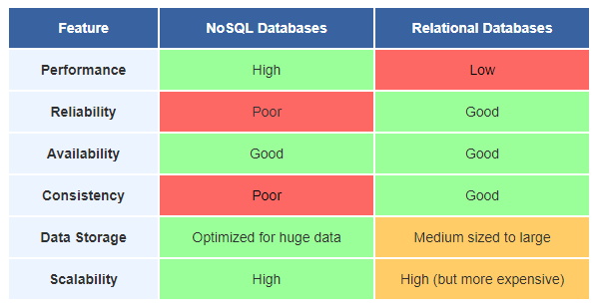
RDBMS vs NoSQL

Slide 4
RDBMS vs NoSQL
RDBMS
Structured query language (SQL)
Structured data with predefined schema
Data and its relationships are stored in separate tables.
Data Manipulation Language (DML), Data Definition Language (DDL)
ACID property (Atomicity, Consistency, Isolation, Durability)
NoSQL
No query language
Unstructured data with no predefined schema
Prioritizes high performance, high availability and scalability
CAP Theorem (Consistency, Availability, Partition Tolerance)
BASE property (Basic Availability, Soft-state, Eventual consistency)

Slide 5
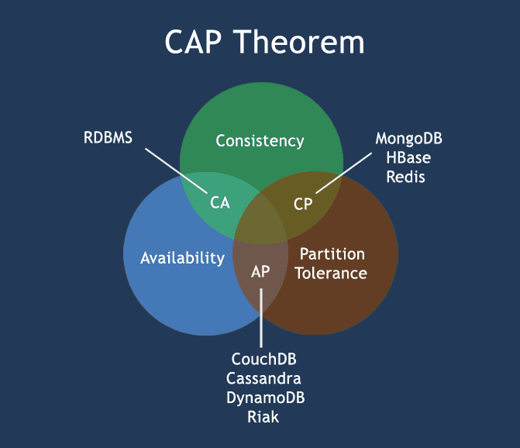
CAP Theorem
Consistency - This means that the data in the database remains consistent after the execution of an operation. For example after an update operation all clients see the same data.
Availability - This means that the system is always on (service guarantee availability), no downtime.
Partition Tolerance - This means that the system continues to function even the communication among the servers is unreliable, i.e. the servers may be partitioned into multiple groups that cannot communicate with one another.

Slide 6
ACID vs BASE
All operations in a transaction succeed or every operation is rolled back.
The database appears to work most of the time.
ACID | BASE
Atomicity | Basically Available
Consistency | Soft state
Isolation | Eventual consistency
Durable
Stores do not have to be write-consistent, nor do different replicas have to be mutually consistent all the time.
At the end of the transaction, all data must be left in a consistent state.
Modifications of data performed by a transaction must be independent of another transactions.
The results of applying a transaction are permanent, even in the presence of failures.
Stores exhibit consistency at some later point.

Slide 7
NoSQL Categories
There are four general types (most common categories) of NoSQL databases. Each of these categories has its own specific attributes and limitations. There is not a single solutions which is better than all the others, however there are some databases that are better to solve specific problems.
Key-Value stores
Document oriented
Column-oriented
Graph

Slide 8
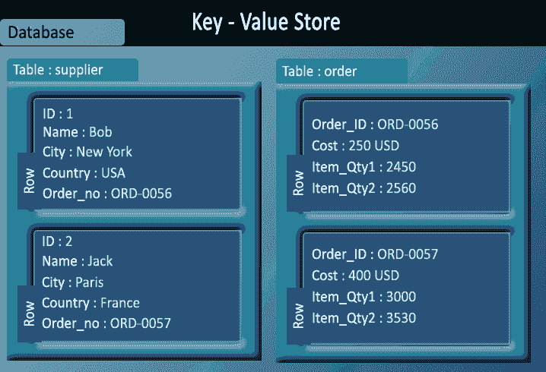
Key-Value stores
Key-value stores are most basic types of NoSQL databases.
Designed to handle huge amounts of data.
Key value stores allow developer to store schema-less data.
In the key-value storage, database stores data as hash table where each key is unique and the value can be String, JSON, BLOB, etc.
Key-Value stores can be used as collections, dictionaries, associative arrays, etc.
Key-Value stores follow the 'Availability' and 'Partition' aspects of CAP theorem.
Key-Values stores would work well for shopping cart contents, or individual values like a landing page URI, or a default account number.

Slide 9
Typical Key-Value API
get(key) -- Extract the value given a key
put(key, value) -- Create or update the value given its key
delete(key) -- Remove the key and its associated value
execute(key, operation, parameters) -- Invoke an operation to the value (given its key) which is a special data structure (e.g. List, Set, Map .... etc.)

Slide 10
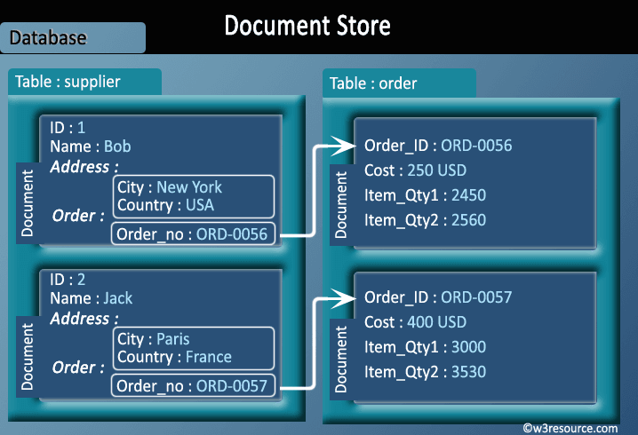
Document Oriented databases
Data in this model is stored inside a collection documents.
A document is a key value collection where the key allows access to its value.
Documents are typically schemaless and therefore are flexible and easy to change.
Documents are stored into collections in order to group different kinds of data.
Documents can contain many different key-value pairs, or key-array pairs, or even nested documents.

Slide 11
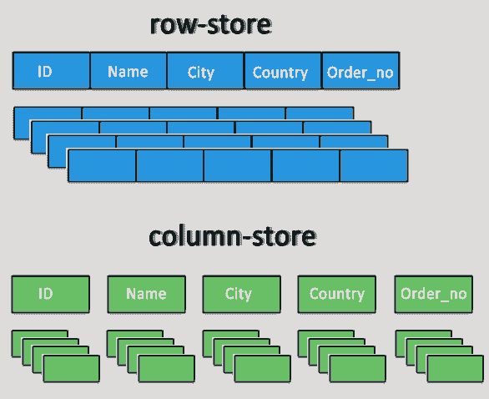
Column-oriented databases
Column-oriented databases primarily work on columns and every column is treated individually.
Values of a single column are stored contiguously.
Column stores data in column specific files.
All data within each column datafile have the same type which makes it ideal for compression.
Column stores can improve the performance of queries as it can access specific column data.
High performance on aggregation queries (e.g. COUNT, SUM, AVG, MIN, MAX).
Works on data warehouses (DW) and business intelligence (BI), customer relationship management (CRM), Library card catalogs, etc.

Slide 12
Graph databases
A graph database stores data in a graph.
It is capable of elegantly representing any kind of data in a highly accessible way.
A graph database is a collection of nodes (vertices) and relationships (edges).
Each node represents an entity (such as a student or business) and each edge represents a connection or relationship between two nodes.
Every node and edge are defined by a unique identifier.
Each node knows its adjacent nodes.
As the number of nodes increases, the cost of a local step (or hop) remains the same.

Slide 13
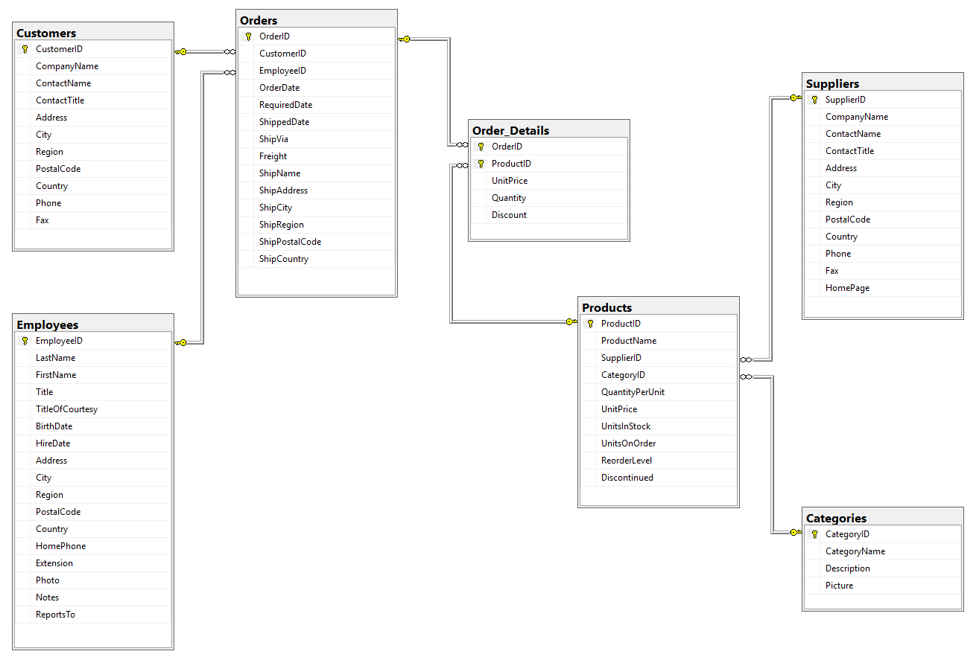
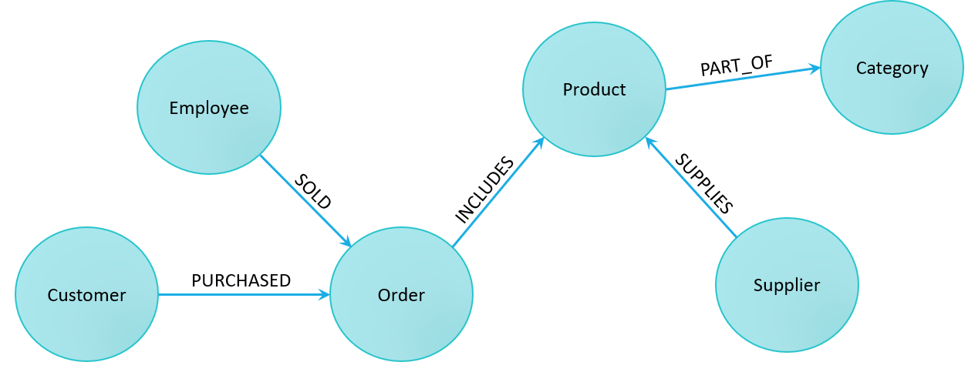
Graph DB – Northwind

Slide 14
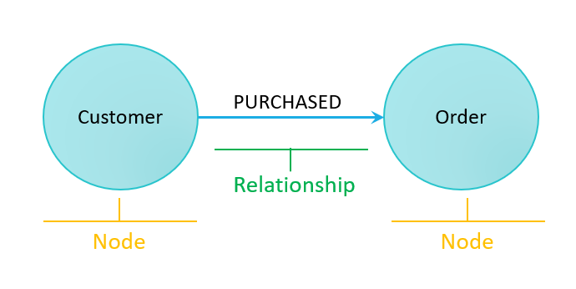
Graph DB - Node and Relationship

Slide 15
Replication and Sharding
Replication copies the entire database across all nodes in the distributed system.
Sharding divides the data inside the database and partitions pieces of it to different nodes. Databases can be sharded horizontally (by rows) or vertically (by columns).

Slide 16
Relational & NoSQL data models
Relational model | Document model | Column-oriented | Graph model
Tables | Collections | Tables | Nodes
Rows | Documents | Rows | Nodes?
Columns | Key/value pairs | Columns | Node Attributes
Relationships | Embedded docs | Relationships | Relationships
MySQL | MongoDB | Redshift | neo4j

Slide 17
Online Tutorial - Assignment
https://www.guru99.com/mongodb-tutorials.html

